Slide 1

Immoweb – Exploratory data Analysis
Evi, Moussa, Yves

Slide 2
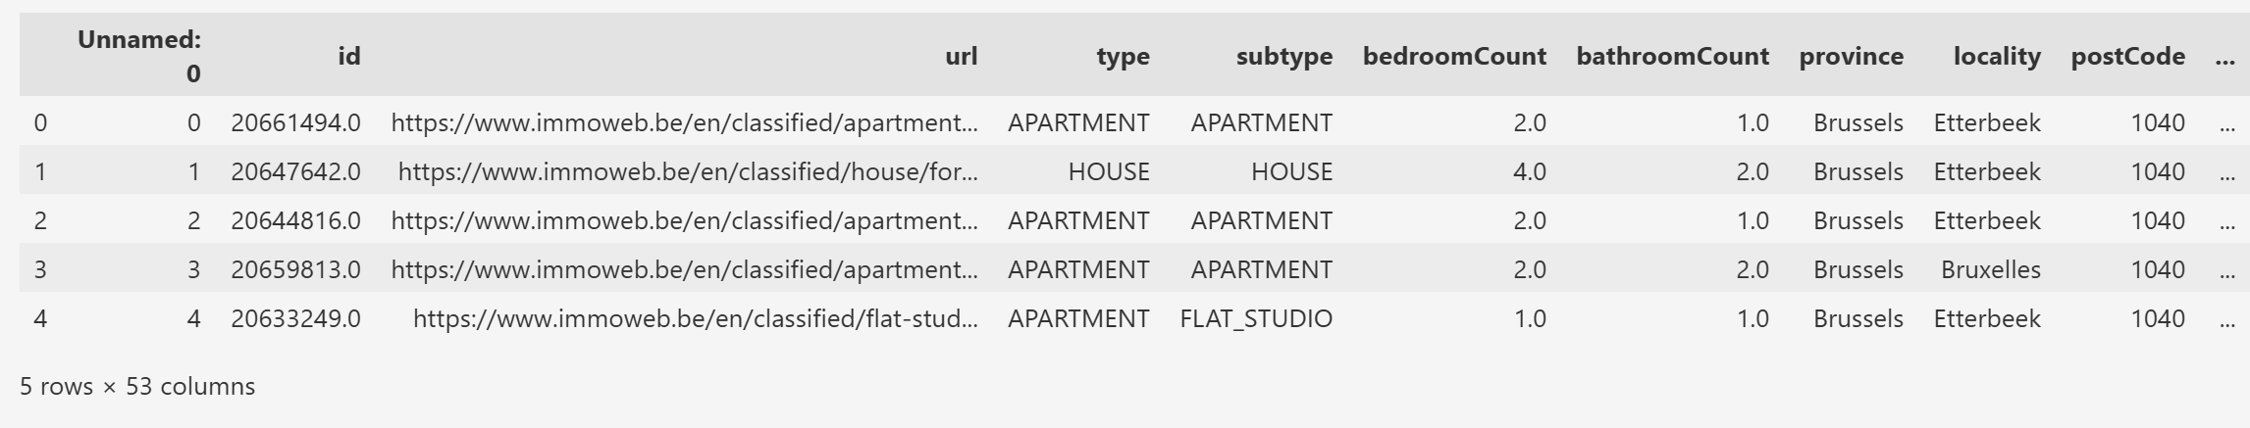
Previewing the Dataset with df.head()
Observation from Dataset Preview
The dataset contains real estate listings with key features such as
property type,
subtype,
number of bedrooms and bathrooms,
location (province, locality, postcode), and a unique listing URL.
From the first 5 rows, we can observe:
A variety of property types (e.g., apartment, house, flat studio)
Listings are located in Brussels, specifically Etterbeek and Bruxelles
Bedroom counts range from 1 to 4, and bathroom counts from 1 to 2

Slide 3
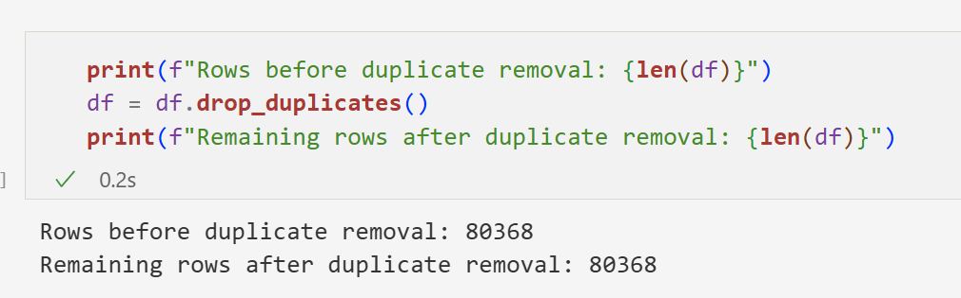
Duplicated values
Observation
No duplicate rows were found in the dataset.
The number of rows remained the same before and after applying drop_duplicates()
→ This confirms that all entries are unique at this stage.

Slide 4
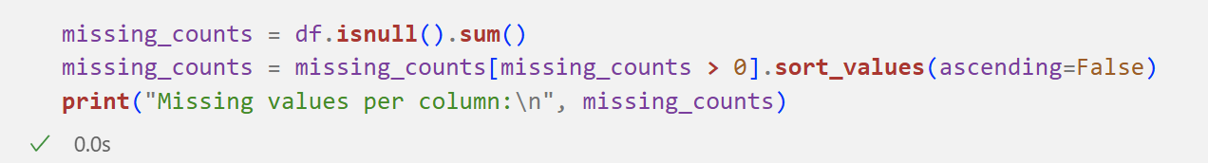
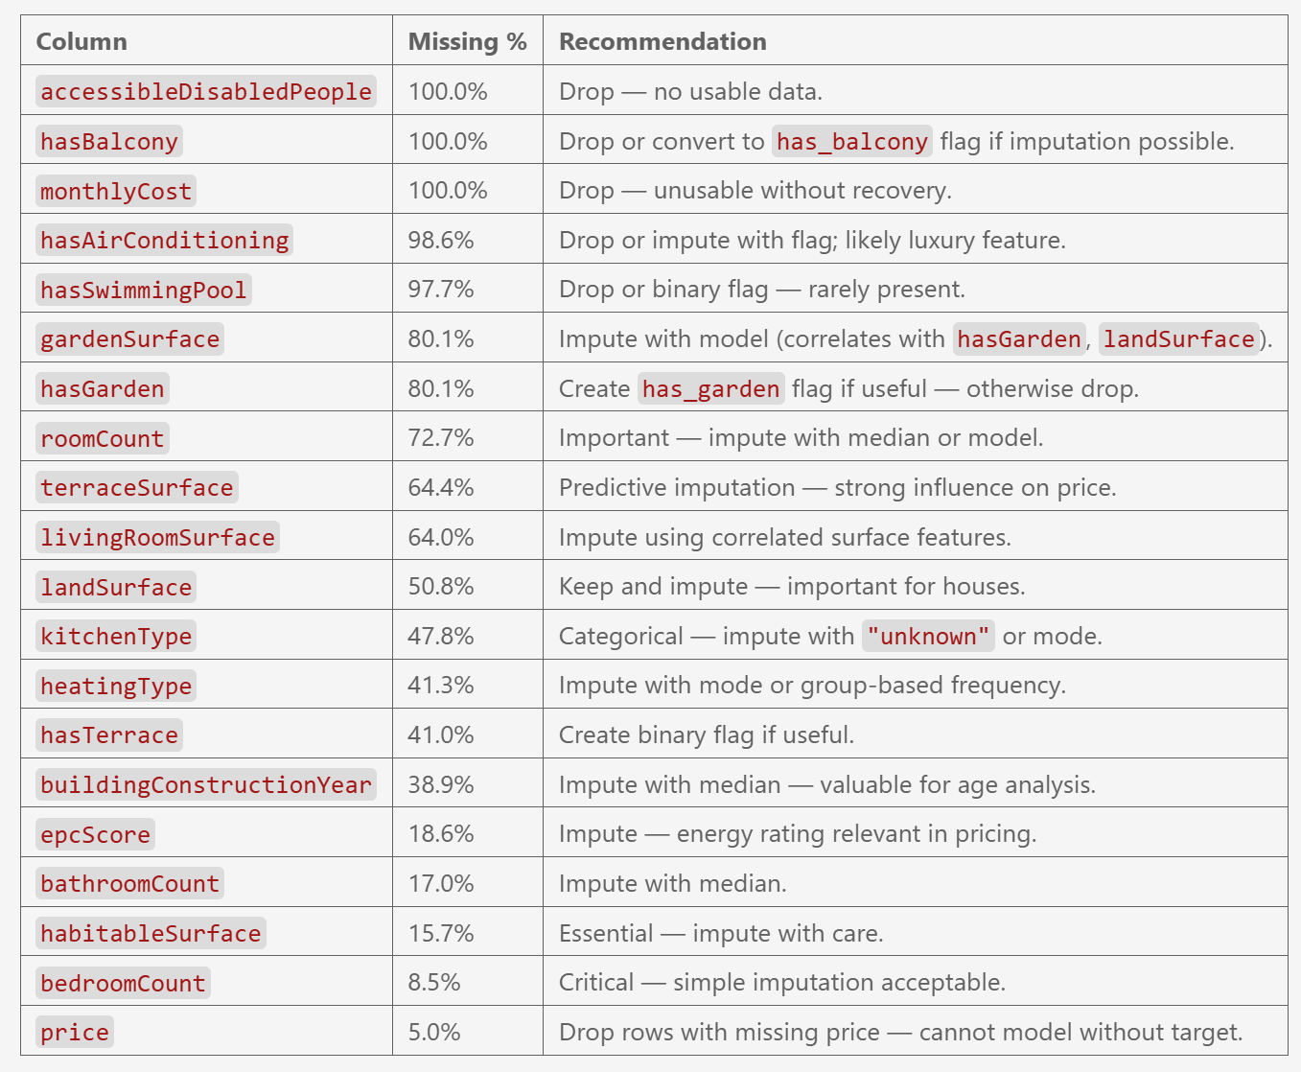
Show Percentage of Missing Values
Key Insight on Missing Data
Drop columns with 100% missing or irrelevant data.
Impute key features (roomCount, terraceSurface, etc.) using median or models.
Fill categorical fields (kitchenType, heatingType) with mode or grouped values.
Remove rows with missing price (target variable).
Keep and impute useful columns (epcScore, constructionYear).

Slide 5



Visualize Missingness
Visual representations of missing values help detect patterns across the dataset:
A heatmap shows missing entries row by row, which can highlight clusters or anomalies.
A bar plot (via `missingno`) summarizes the missing value count per feature, sorted for easier prioritization.
These visualizations support decision-making when choosing which columns to
drop,
impute,
or transform.
Notes:
Let’s now focus on the median, the second measure of central tendency.
The median is the middle value when your data is ordered. It literally splits your dataset into two equal halves.
This measure is especially powerful when dealing with skewed data or extreme values. Unlike the mean, the median doesn’t get distorted by a few very large or very small numbers — which makes it a much more robust indicator of what’s typical in many real-world situations.
In this part, we’ll explore what the median tells us, how to calculate it, and why it stays stable even when outliers are present — like a CEO’s salary.
So while the mean might tell you the average, the median often tells you what’s fair.

Slide 6
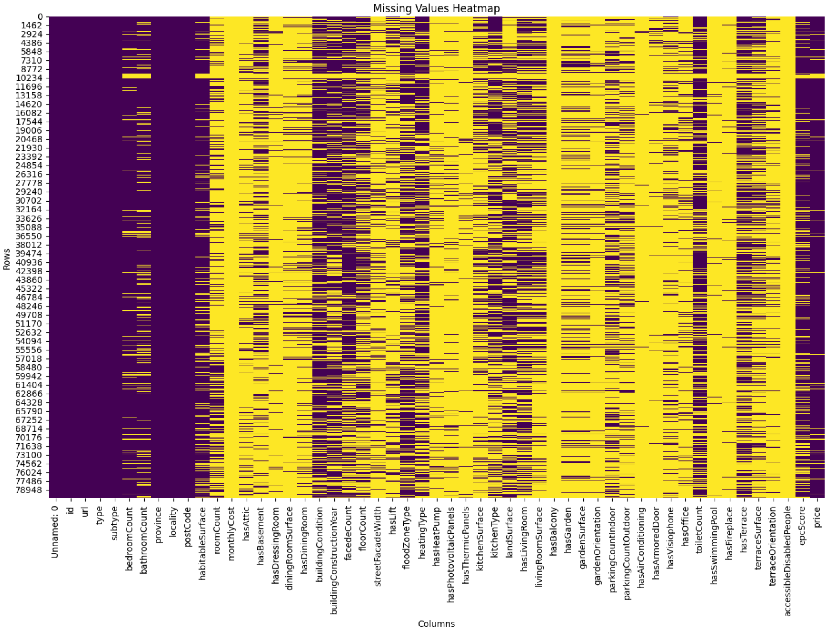
Visualize Missingness – Heatmap using seaborn
Missing Values Heatmap
Yellow indicates missing values
Purple indicates available (non-missing) values
We observe:
Several columns (far right) are mostly yellow, meaning they are almost entirely missing
Most columns have partial missingness, requiring selective imputation
A few columns (left side) are fully populated (purple), and can be safely used
This confirms the need for a hybrid cleaning strategy: drop, impute, or filter depending on importance.

Slide 7
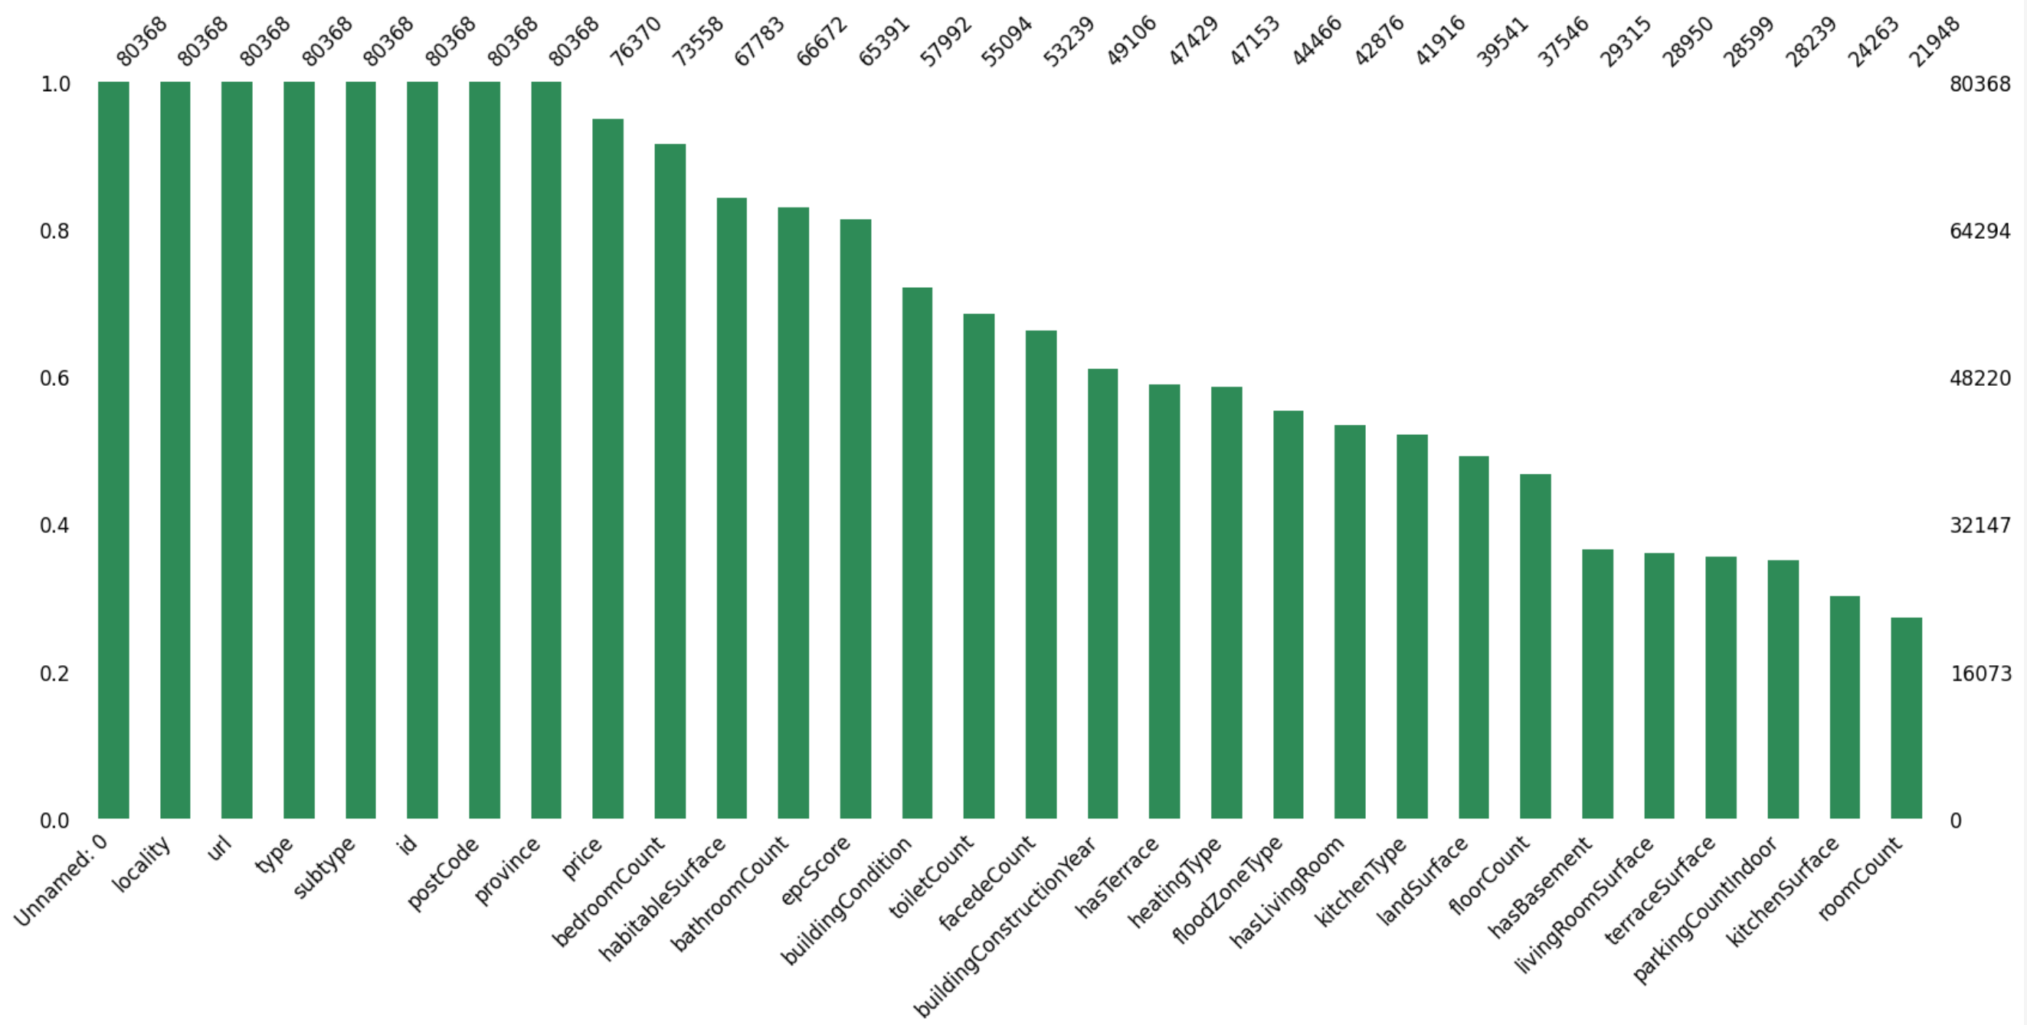
bar plot (via `missingno`) summarizes the missing value count per feature
Column Completeness Overview
Several key variables
“price”, “bedroomCount”,”habitableSurface”, “bathroomCount”
→ are nearly complete and suitable for modeling.
“Surface” & “Room Count” show significant missing values
→ and require imputation or exclusion.
This distribution supports a hybrid data preparation strategy:
retain and clean the most populated columns,
selectively handle incomplete ones based on their importance.

Slide 8
Dataset cleaning
Columns and rows with missing impact
Assessing impact
Notes:
Let’s now focus on the median, the second measure of central tendency.
The median is the middle value when your data is ordered. It literally splits your dataset into two equal halves.
This measure is especially powerful when dealing with skewed data or extreme values. Unlike the mean, the median doesn’t get distorted by a few very large or very small numbers — which makes it a much more robust indicator of what’s typical in many real-world situations.
In this part, we’ll explore what the median tells us, how to calculate it, and why it stays stable even when outliers are present — like a CEO’s salary.
So while the mean might tell you the average, the median often tells you what’s fair.

Slide 9
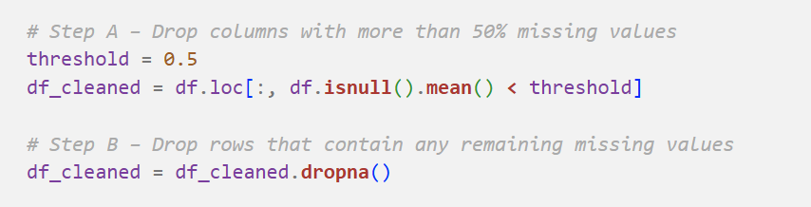
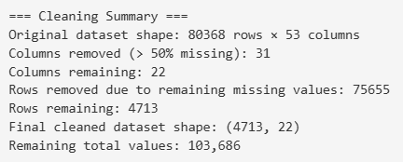
Save new dataset with missing values removed
Cleaning Impact
The original dataset contained 80,368 rows × 53 columns.
A total of 31 columns (with over 50% missing data) were dropped.
75,655 rows with partial missing values were also removed.
Final cleaned dataset: 4,713 rows × 22 columns, fully complete.
Despite the significant reduction, the remaining 103,686 values form a robust and reliable dataset for modeling.

Slide 10
Identify variable types in the cleaned dataset
Quantitative variables (numerical):['Unnamed: 0', 'id', 'bedroomCount', 'bathroomCount', 'postCode', 'habitableSurface', 'buildingConstructionYear', 'facedeCount', 'toiletCount', 'price’]
Qualitative variables (categorical):['url', 'type', 'subtype', 'province', 'locality', 'buildingCondition', 'floodZoneType', 'heatingType', 'kitchenType', 'hasLivingRoom', 'hasTerrace', 'epcScore']
- Quantitative variables are numerical and can be used in mathematical operations, plots, and statistical summaries.
- Qualitative variables (also called categorical) describe categories or labels and often require encoding or grouping before use in machine learning.
Variable Types Identified
The cleaned dataset includes a mix of quantitative (numerical) and qualitative (categorical) variables.
Numerical features (e.g. price, bedroomCount, habitableSurface) are ready for statistical analysis and modeling.
Categorical features (e.g. type, province, heatingType) will require encoding or grouping before use in machine learning models.

Slide 11
Data analysis
Distribution visualization
Most & least expensive
Most influential variables on price
Variables with Low or No Impact
Encoding Strategy for Categorical Variables
Notes:
Let’s now focus on the median, the second measure of central tendency.
The median is the middle value when your data is ordered. It literally splits your dataset into two equal halves.
This measure is especially powerful when dealing with skewed data or extreme values. Unlike the mean, the median doesn’t get distorted by a few very large or very small numbers — which makes it a much more robust indicator of what’s typical in many real-world situations.
In this part, we’ll explore what the median tells us, how to calculate it, and why it stays stable even when outliers are present — like a CEO’s salary.
So while the mean might tell you the average, the median often tells you what’s fair.

Slide 12
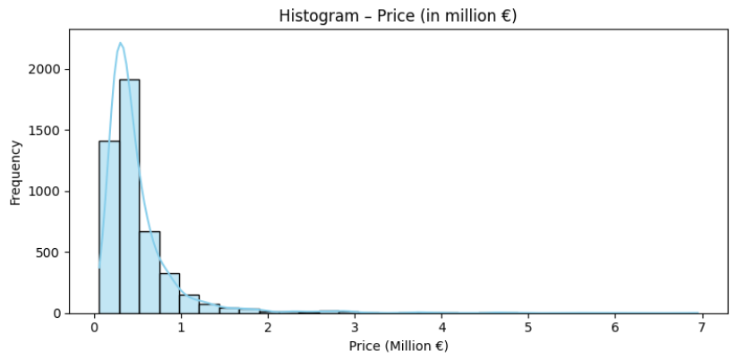
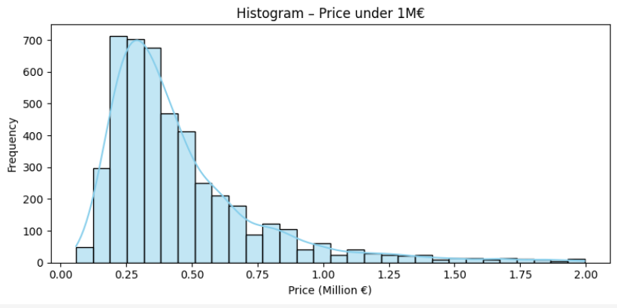
Distribution visualization
Price Distribution
The overall price distribution is right-skewed, with a long tail of high-priced properties.
Most listings are concentrated below €1 million, justifying a focused view on this price range.
The filtered histogram (under €1M) reveals a peak around €250,000–€400,000, aligning with typical residential property prices.
Outliers above €1M should be handled carefully during modeling (e.g., scaling, trimming, or log transformation).

Slide 13
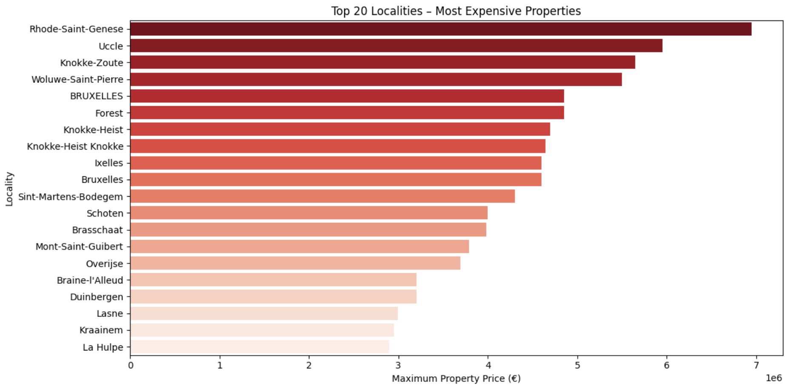
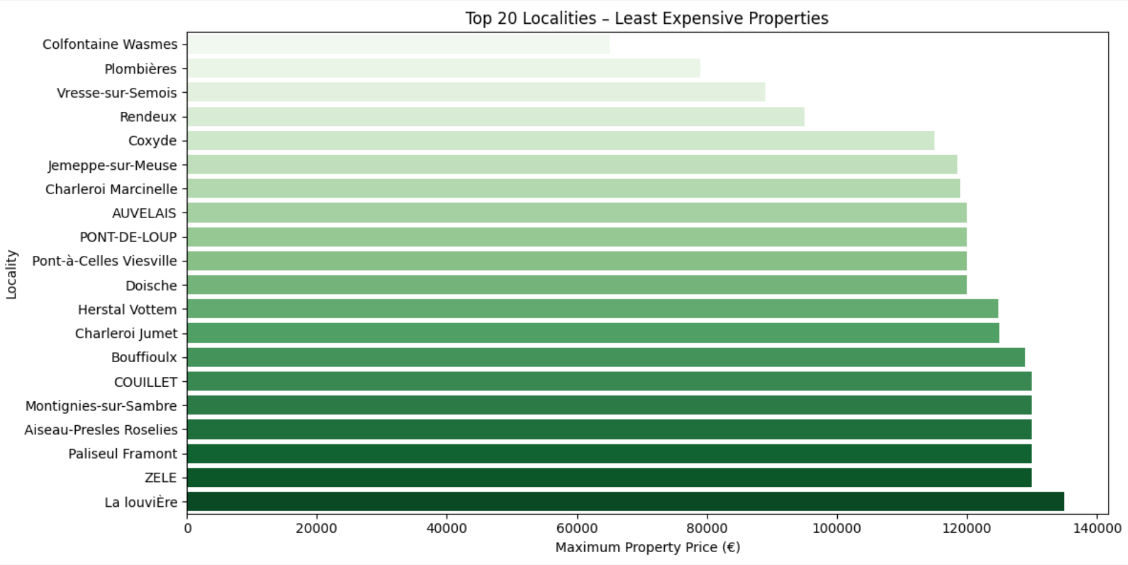
Most & Least Expensive per town
Price Extremes by Locality
Most expensive localities include
Rhode-Saint-Genèse, Uccle, and Knokke-Zoute,
→ with maximum prices exceeding €6 million.
Least expensive areas such as
La Louvière, Zele, and Pasilieu Ramont
show max prices below €140,000,
→ indicating strong regional disparities.
This contrast highlights regional and socioeconomic gaps
→ key for location-based modeling.

Slide 14
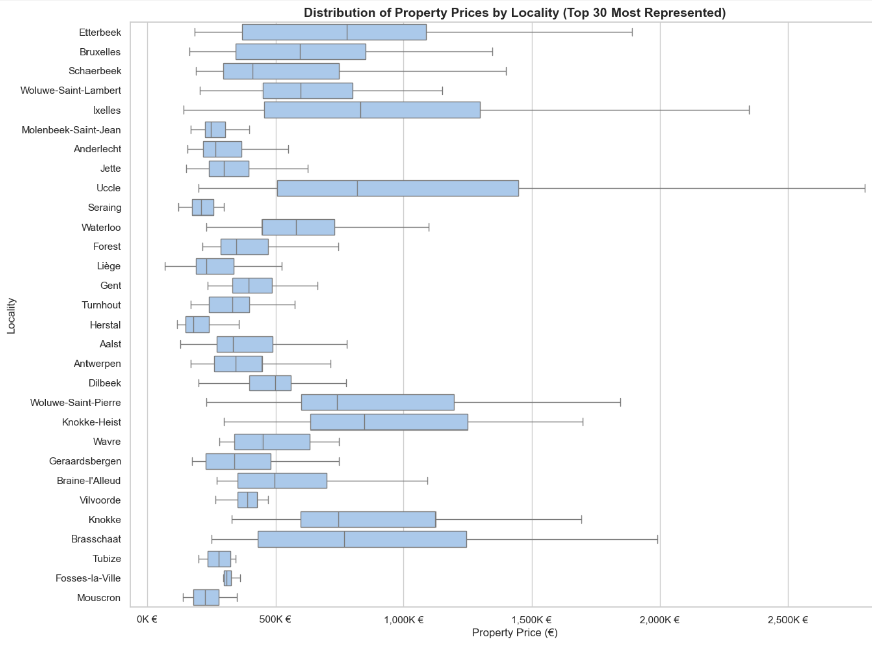
Price Distribution by Locality
Price Extremes by Locality
Property prices show strong variation by locality.
Ixelles, Uccle, and Knokke stand out as high-end areas,
Mouscron, Tubize, and Fosses-la-Ville represent the lower end.
Location remains a key factor in pricing dynamics.

Slide 15
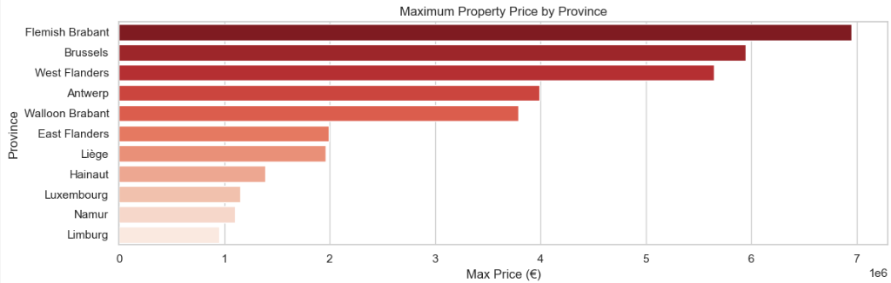
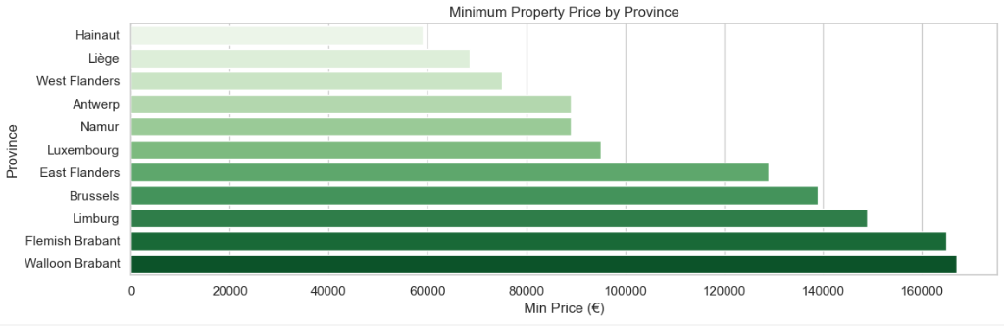
Most & Least Expensive per province
Price by Province
Flemish Brabant, Brussels, and West Flanders have the highest maximum property prices, reaching up to €6–7 million.
Walloon provinces like Hainaut and Liège have the lowest minimum prices, below €50,000.
This wide price range across provinces highlights the importance of regional pricing strategies in real estate modeling.

Slide 16
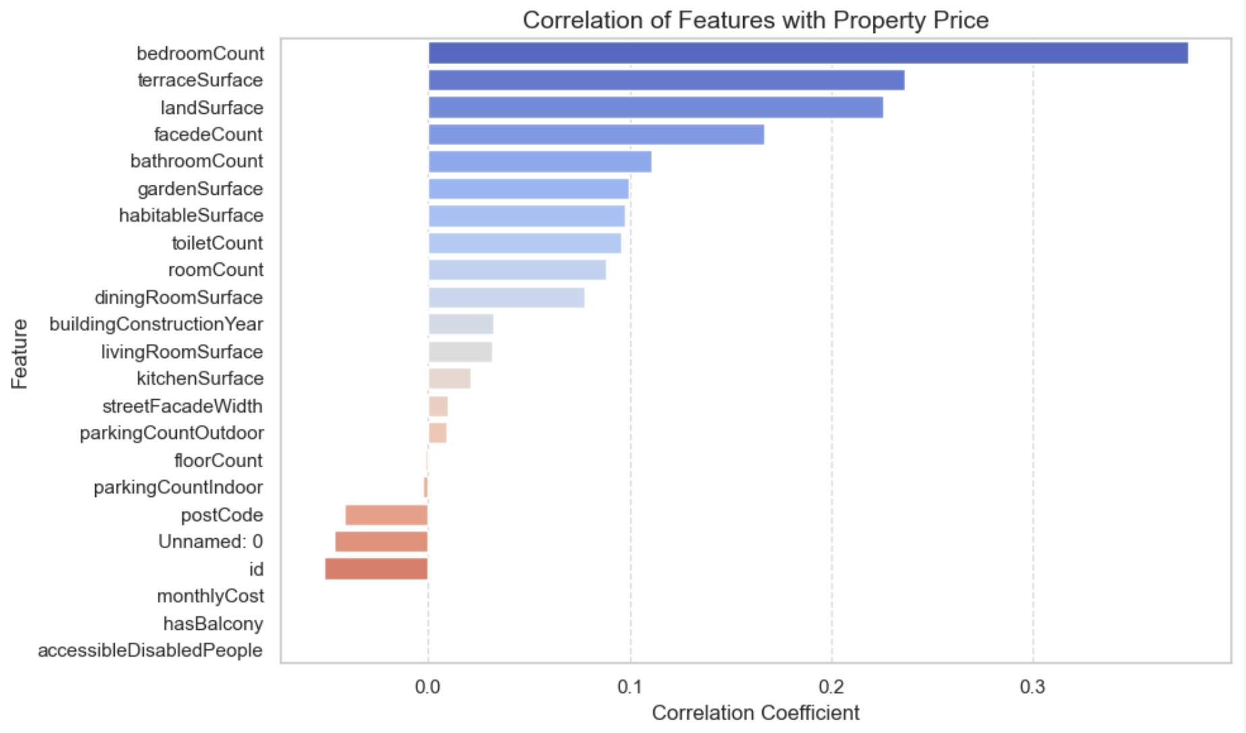
Most influential variables on price
Price Correlation Insights
The most correlated features with property price are bedroom count, terrace surface, and land surface.
Surface-related variables dominate the top influencers, confirming that size matters most in real estate valuation.
Some features (e.g., monthlyCost, hasBalcony) show negative or negligible correlation, and may require further validation or exclusion from models.

